Slide 1
Energy Analysis
Higgins & Divya Peter
12.12.2024
A visualtimelineanalysis of energy production from the IEA Monthly Energy Statistics data along with population and weather data.

Slide 2
Goal: Conduct Analysis of Four European State’s Energy Mix
Research Questions to answer:
What is the current energy mix and how has it evolved over the 5 year intervals?
How much has been imported and exported, monthly, yearly, overall.
How much has energy consumption grown in the last 5 years?

Slide 3
Basic vocabulary and metrics to know:
Balance: How much energy is produced imported, exported and lost in the system to match real-time demand.
kWh(KiloWatt hour): 1000 watts used per hour, used to measure consumption
GWh (GigaWatt hour): 1 million kWh used in large energy consumption measure making it useful for large grids and monthly country metrics

Slide 4
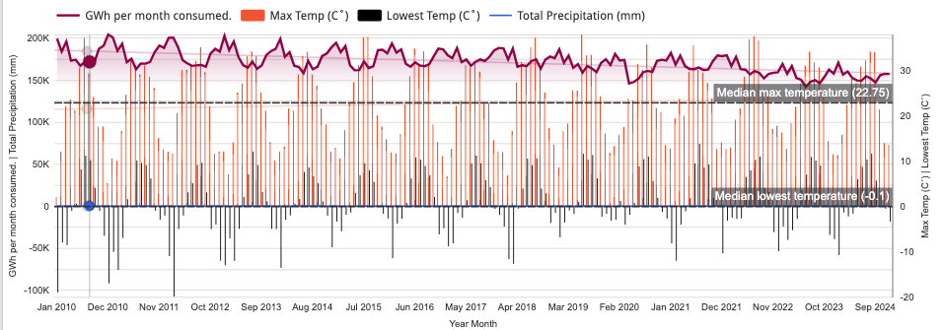
First our data visualisations
1

Slide 5
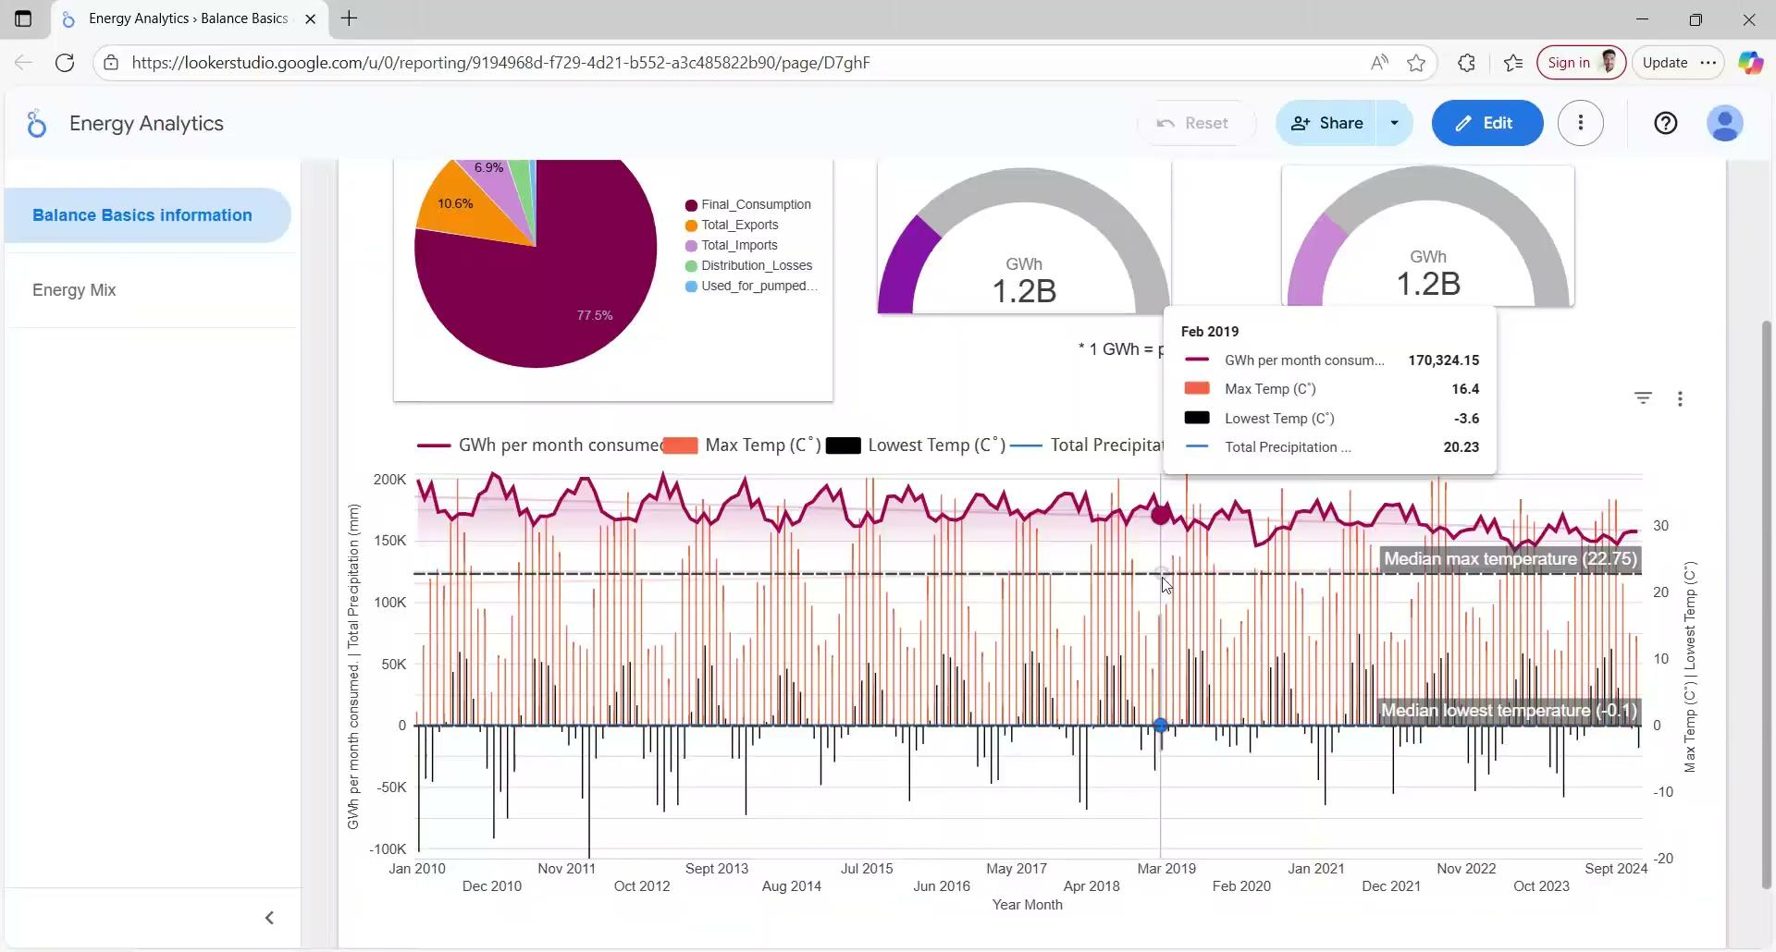
First our data visualisations
1
Notes:
Pie chart: Total proportion of energy supply in balance
Gagess show:
Net Supply = Net Electricity Produced + (Imports - Exports)
Gross Available Energy = Final Consumption + Distribution Losses (and sometimes transformation losses, auxiliary loads).

Slide 6
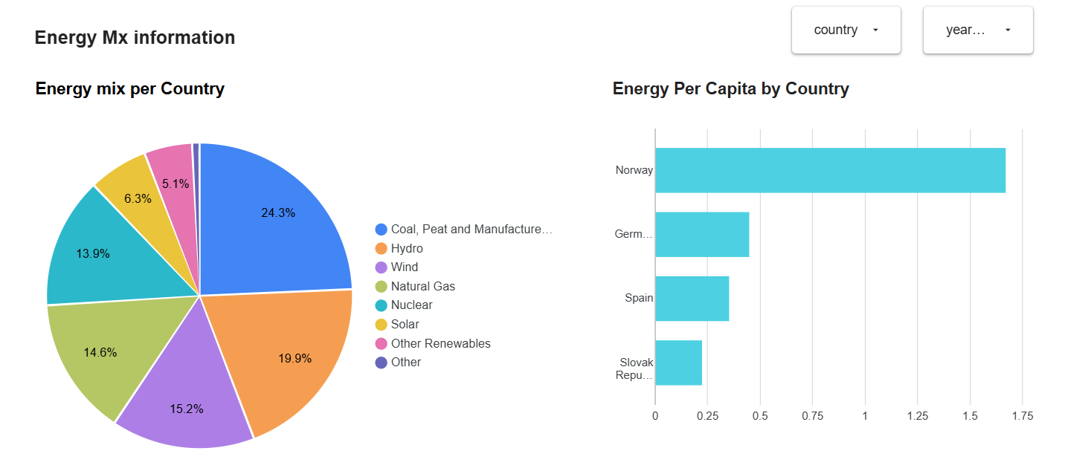
First our data visualisations
1

Slide 7
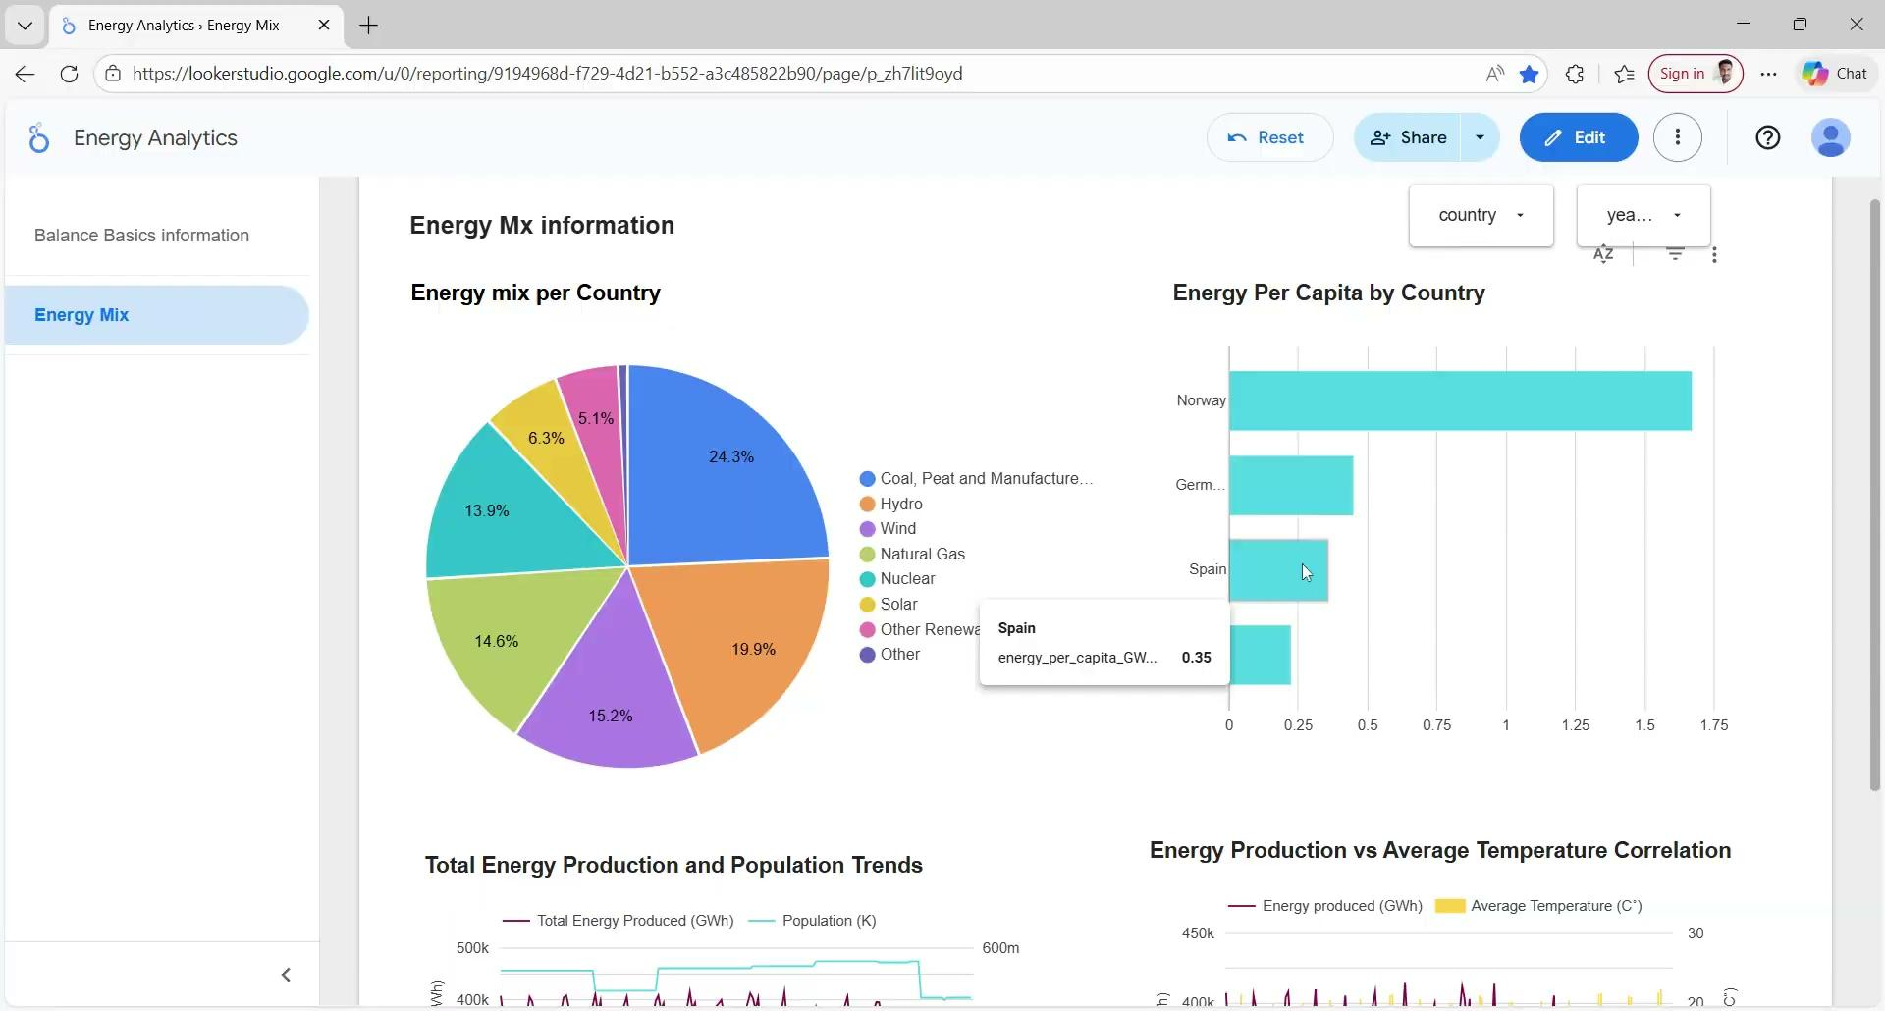
First our data visualisations
1

Slide 8

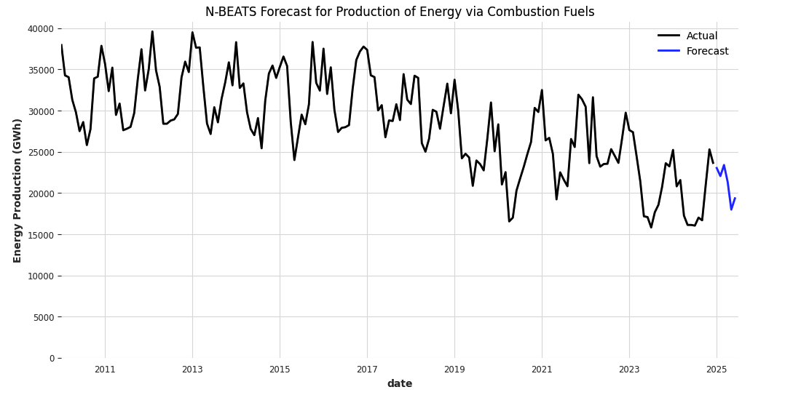
Two basic models of Germany’s production of energy from renewables and fossil fuels
Company Name
12.12.2025
Notes:
MAPE is Mean Absolute Percent Error - because energy production is seasonal it is okay to see the renewables at 30% because renewable energy sources can be turned off or on in case of the needs of the electricity grid to stay stable.

Slide 9
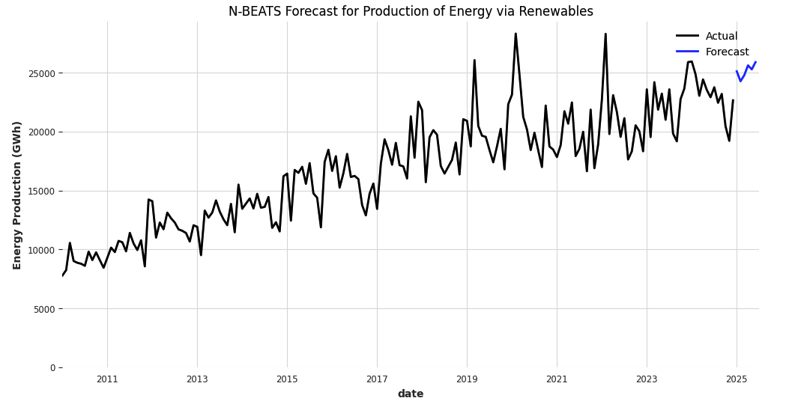
Two basic models of Germany’s production of energy from renewables and fossil fuels
Company Name
12.12.2025
Notes:
MAPE is Mean Absolute Percent Error - because energy production is seasonal it is okay to see the renewables at 30% because renewable energy sources can be turned off or on in case of the needs of the electricity grid to stay stable.

Slide 10
Key takeaways
Company Name
12.12.2025
1
2
Renewables are a growing percent of energy production in Germany, Spain, Norway, Slovak Republic.
Energy production went down during covid and we see less production.

Slide 11

Ask us anything!

Slide 12

Resources
Looker Studio Energy Analytics Dashboard
Packages: darts and pandas
Data we used
  International Energy Agency Monthly Energy Statistics
  Weather Data - VisualCrossing
  Population data - API NINJA
Questions?
Please reach out to
name@example.com
Thank you!

Slide 13
Next Steps
Look further into the models and break it down by electricity production source.
Compare to the Nationally Determined Contributions that outlined planned renewable energy production. (as a covariate - add to models )
Look into commitments on electricity infrastructure transmission (as a covariate - add to models )
Automate the update of data monthly in dashboard from the IEA

Slide 14
Steps in the process
Date
Dec3rd - 6th
Dec 7th
Dec 8th -9th
Dec. 10th
Dec 11th
Today
Gather data
Data sources:
IEA Monthly Energy Statistics
API NINJA - Historical Population
Visual Corssing Weather data
Data Wrangling
Celebrate your first major achievement. This could be a new feature, your 100th user or download, etc.
Building Dashboards
This can be an extension of your previous milestone, or something completely new.
Modeling energy mix composition using Darts
Describe any major organizational events, such as mergers or acquisitions.
Apply to other countries data
List any new features, product lines, subscriber tiers, or marketing activities.
Mention current efforts, such as features you're launching or opportunities you're pursuing. If possible, connect these to the purpose of the demo.

Slide 15
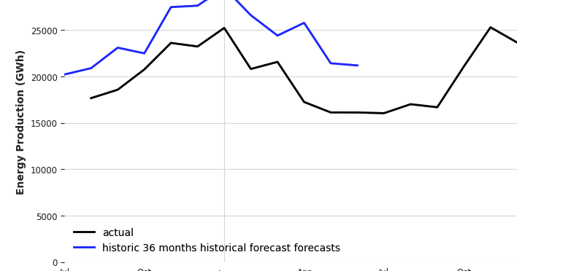
Checks - N-BEATS

Slide 16
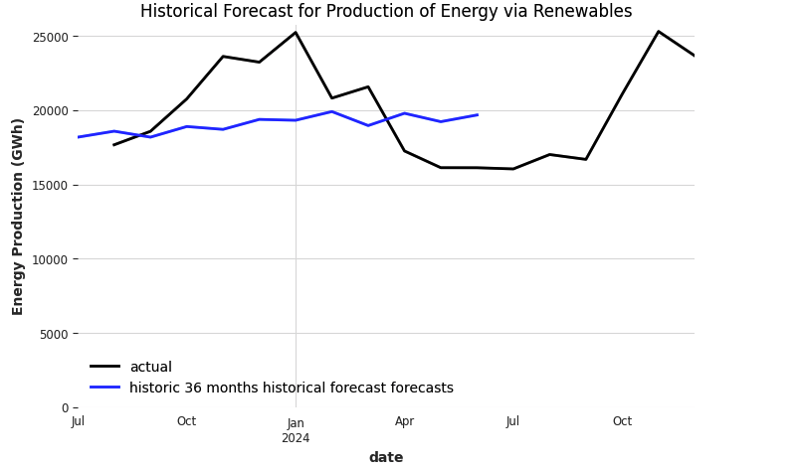
Checks N-BEATS

Slide 17
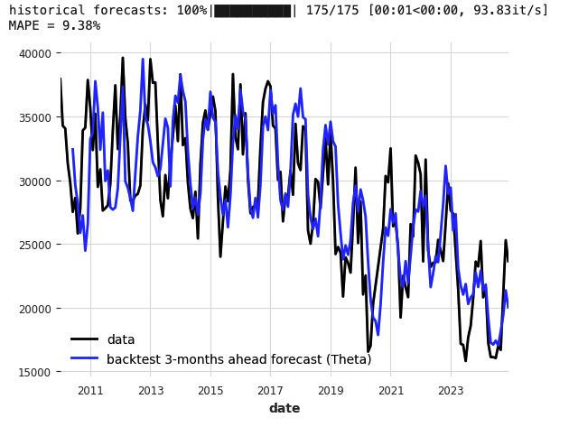
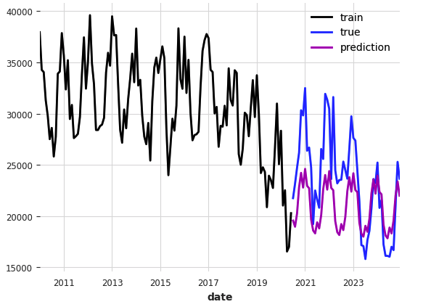
Checks - Ensemble Model

Slide 18
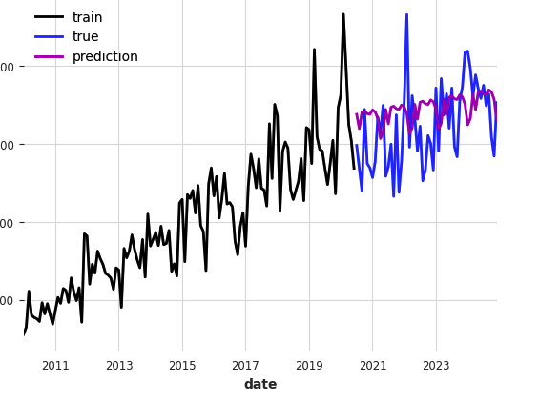
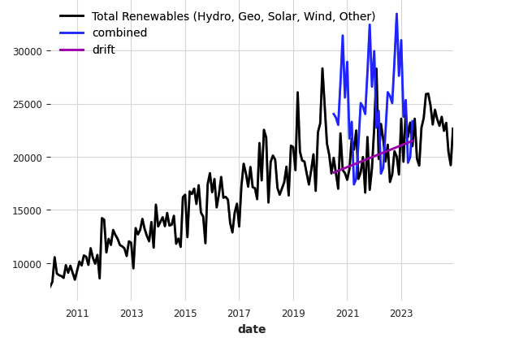
Checks - Ensemble Model

